Slide 1
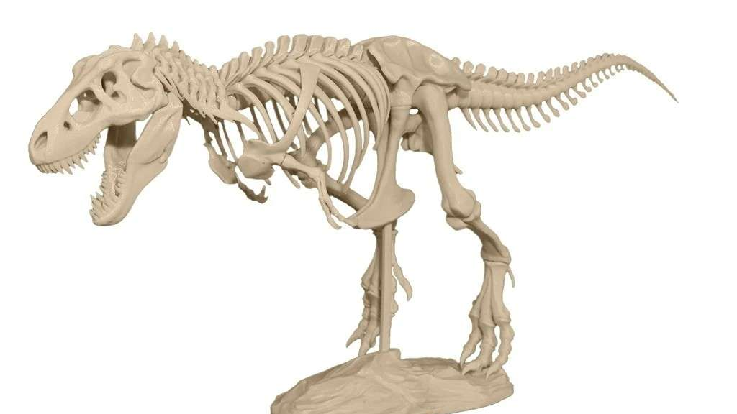
Industrial Robotic Animatronic
Demo
Group 21

Slide 2




Meet The Team
Austin Berg
Electrical Engineering
Armando Diaz
Computer Engineering
Melvin Guzman
Electrical Engineering
Tony Torres
Electrical Engineering

Slide 3
Background & Motivation
In the world of modern engineering and entertainment, animatronics stand at the intersection of creativity, technology, and innovation, captivating audiences and pushing the boundaries of what machines can achieve. From their origins in theme parks to their growing presence in museums, theatrical productions, and public displays, animatronics have become a symbol of storytelling brought to life through precision and artistry. These robotic creations, controlled by advanced systems, seamlessly blend lifelike movements with interactivity, creating immersive experiences that inspire wonder and curiosity.
Our project aims to explore and contribute to the fascinating field of animatronics and robotics by designing and developing an animatronic robot that integrates industry-standard technologies such as Programmable Logic Controllers (PLC) systems and Human-Machine Interfaces (HMI).
The motivation behind this project stems from the desire to combine engineering expertise with creative expression to build a platform that not only entertains but also educates and inspires.

Slide 4
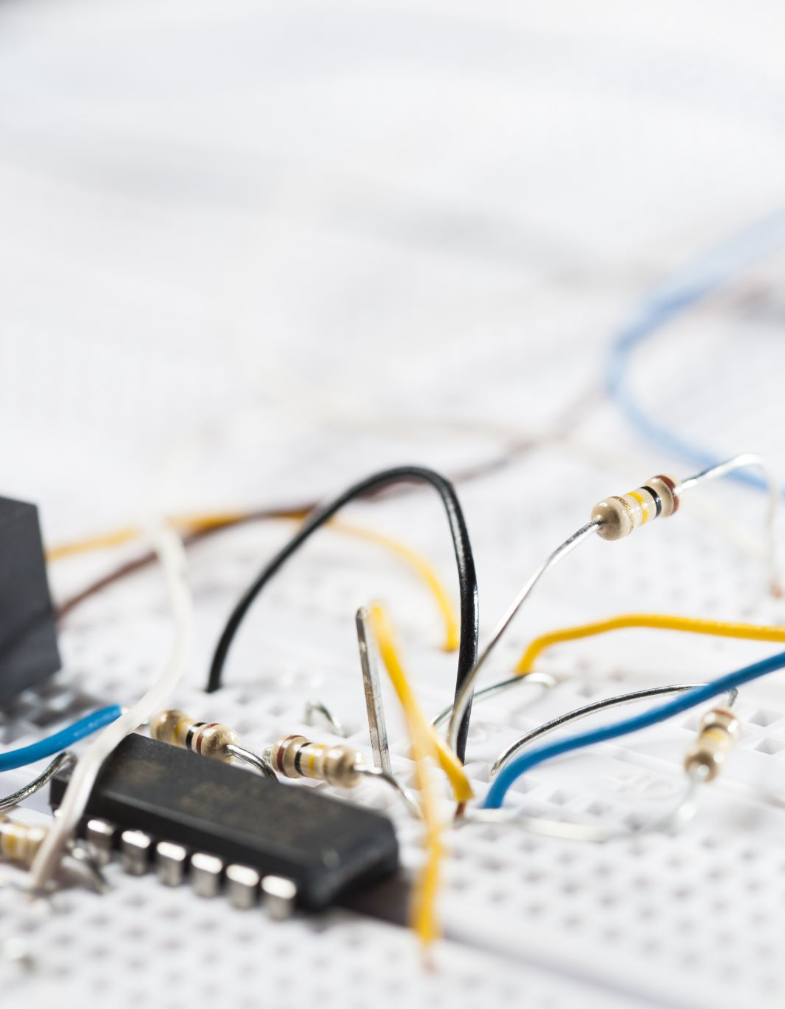

Goals & Objectives
Our main goal in this project is to design and build a functional animatronic robot that demonstrates movement and interaction.
Movement
  Implement servo motors for smooth programmable robotic motion.
  Design and fabricate a custom PCB to centralize control and reduce wiring complexity
  Ensure reliable power delivery and protection using voltage regulators and circuit breakers.
Interaction
  Develop an intuitive HMI for basic user interaction.
Testing & Integration
  Conduct full system testing to verify functionality of motion, power, and interface subsystems.
  Debug and finalize integration prior to the demonstration deadline.
  NOTE: Goals on left hand side, Objectives on right hand side

Slide 5
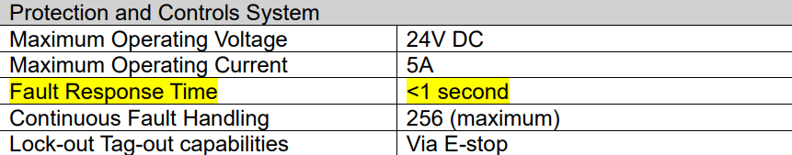
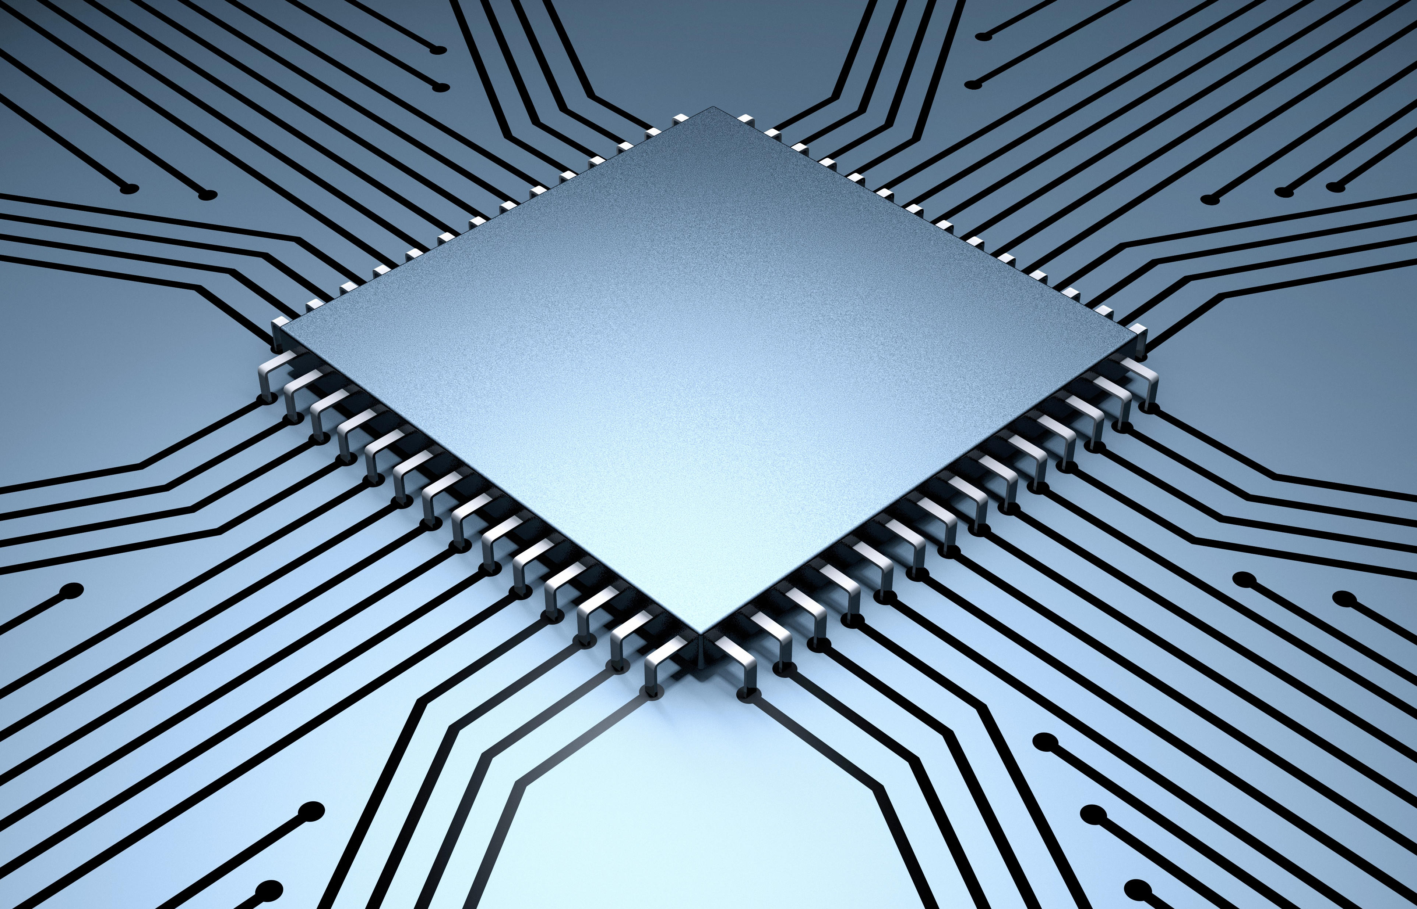
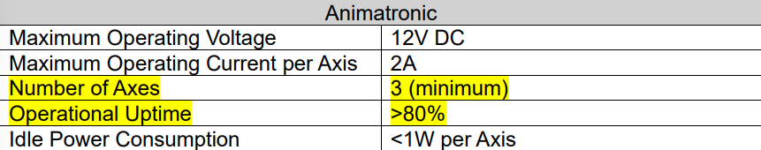
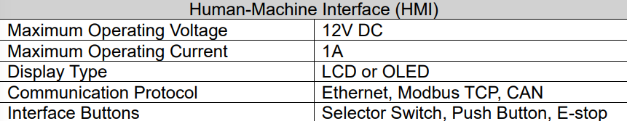
Engineering Specifications

Slide 6
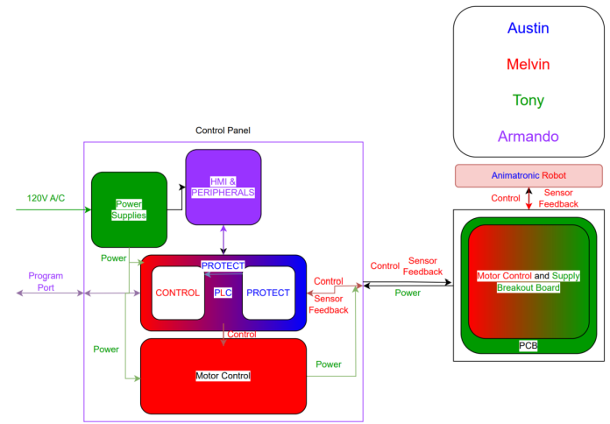
Hardware Diagram
Make image clearer

Slide 7
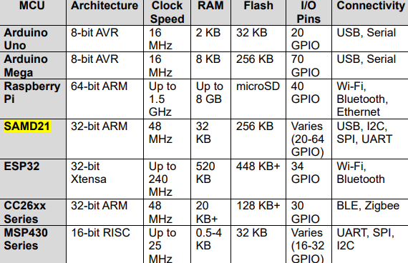
Hardware Technology Comparison/Selection
(MCU)

Slide 8
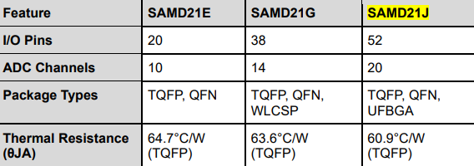
Hardware Part Comparison/Selection
(MCU)

Slide 9
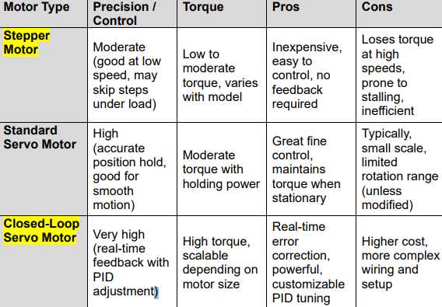
Hardware Technology Comparison
(Motor Types)

Slide 10
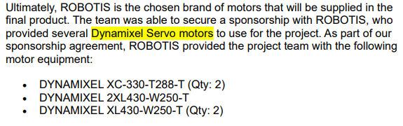
Hardware Part Comparison/Selection
(Motor Types)

Slide 11
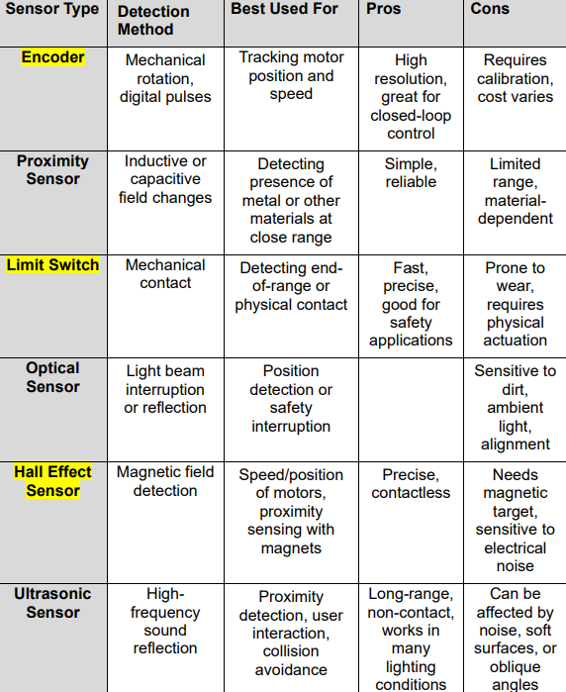
Hardware Technology Comparison
(Sensors)

Slide 12
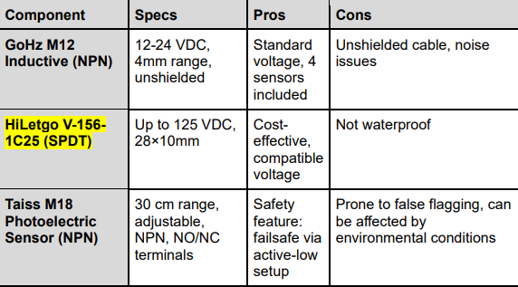
Hardware Part Comparison/Selection
(Sensors)

Slide 13
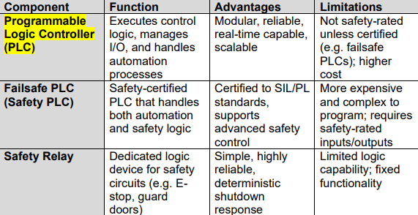
Hardware Technology Comparison/Selection (Protection System)

Slide 14
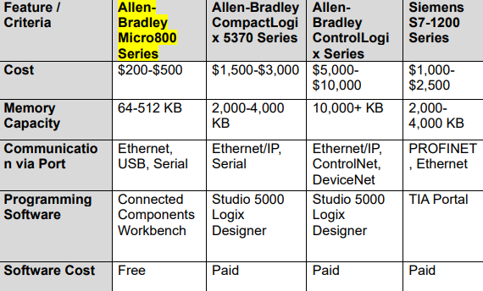
Hardware Part Comparison/Selection
(Protection System)

Slide 15
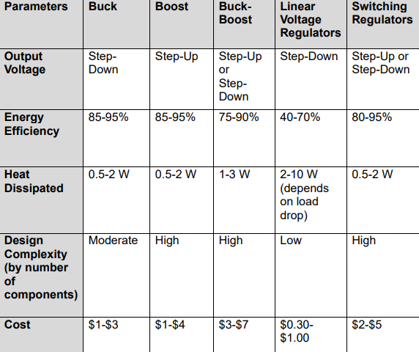

Hardware Technology Comparison
(Voltage Regulator)

Slide 16
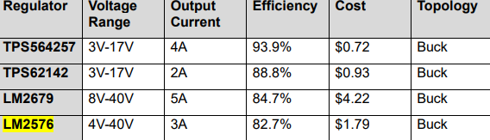
Hardware Part Comparison/Selection
(Voltage Regulator)

Slide 17
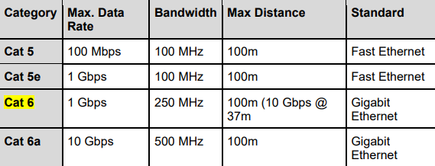
Hardware Part Comparison
(Ethernet Switch)

Slide 18
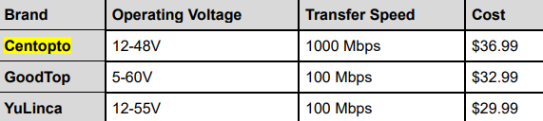
Hardware Part Comparison/Selection
(Ethernet Switch)

Slide 19
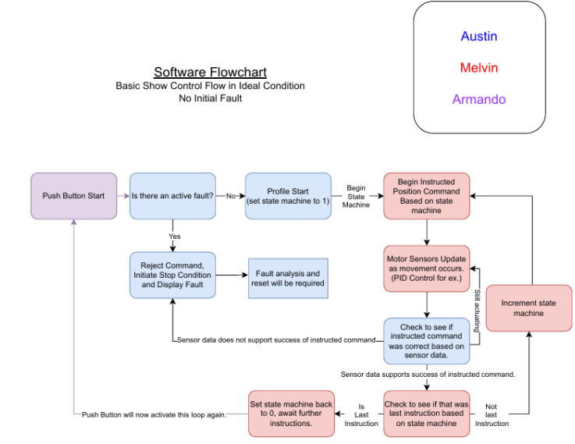
Software Diagram

Slide 20
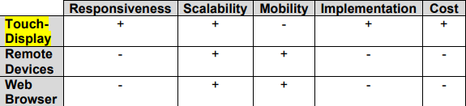
Software Technology Comparison/Selection
(HMI)

Slide 21
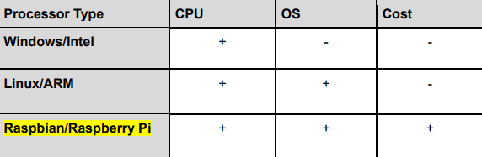
Software Component Comparison/Selection
(HMI)

Slide 22
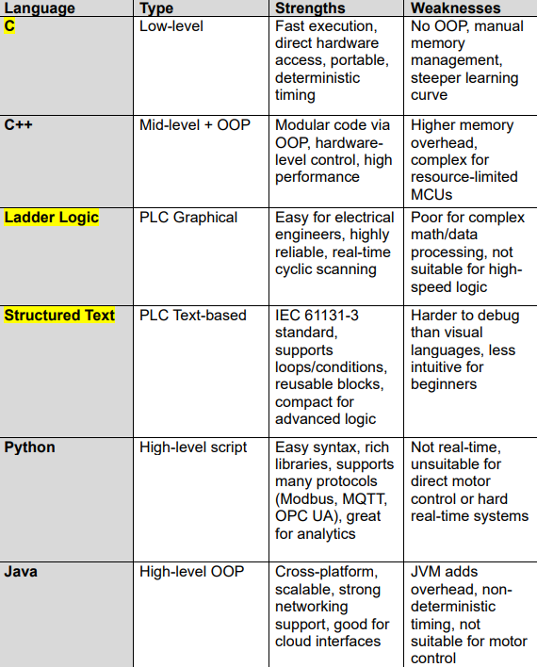
Software Technology Comparison
(Programming Languages)

Slide 23
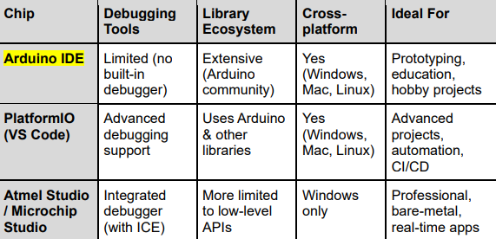
Software Component Comparison/Selection
(Programming IDE)

Slide 24
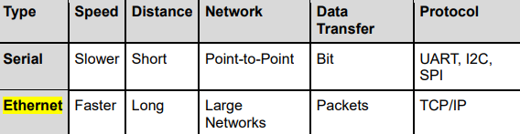
Software Technology Comparison
(Serial vs. Ethernet)

Slide 25
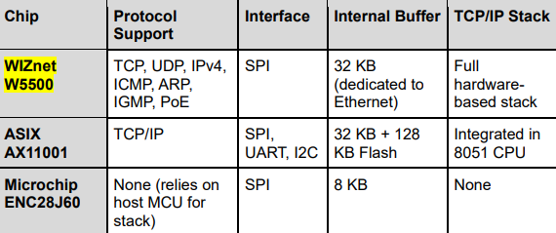
Software Component Comparison/Selection
(Ethernet IC)

Slide 26
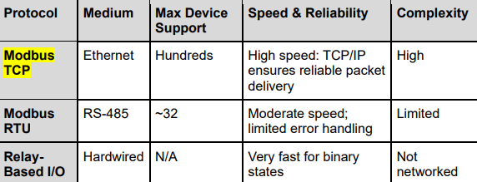
Software Technology Comparison/Selection
(Modbus)

Slide 27
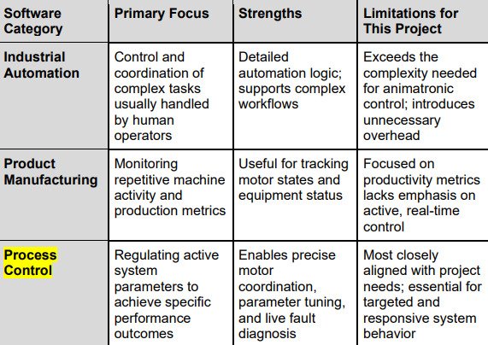
Software Technology Comparison/Selection
(HMI Software)

Slide 28
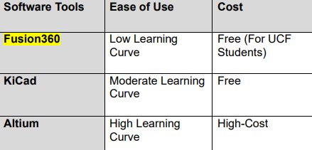
Software Technology Selection (Software for PCB)

Slide 29
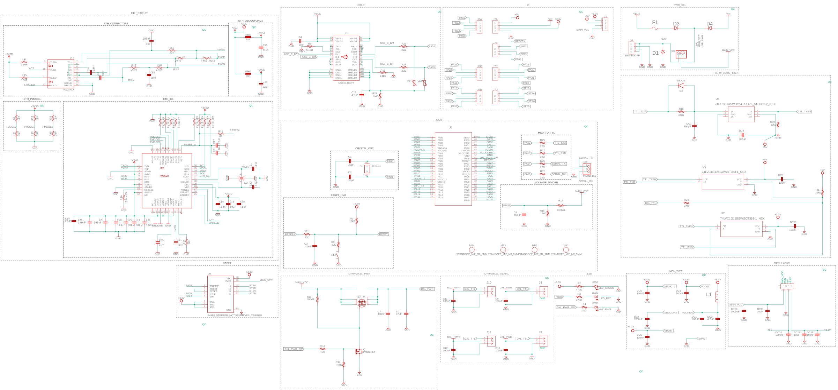
Main Board Schematic

Slide 30
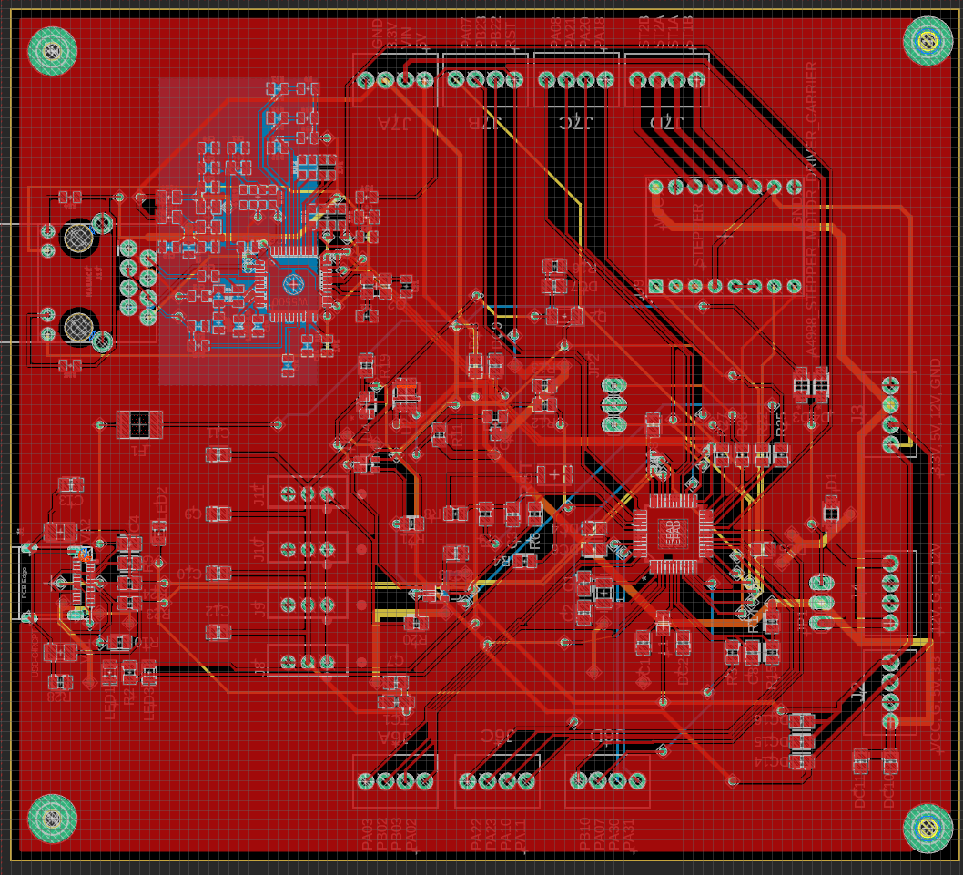
PCB Layout

Slide 31
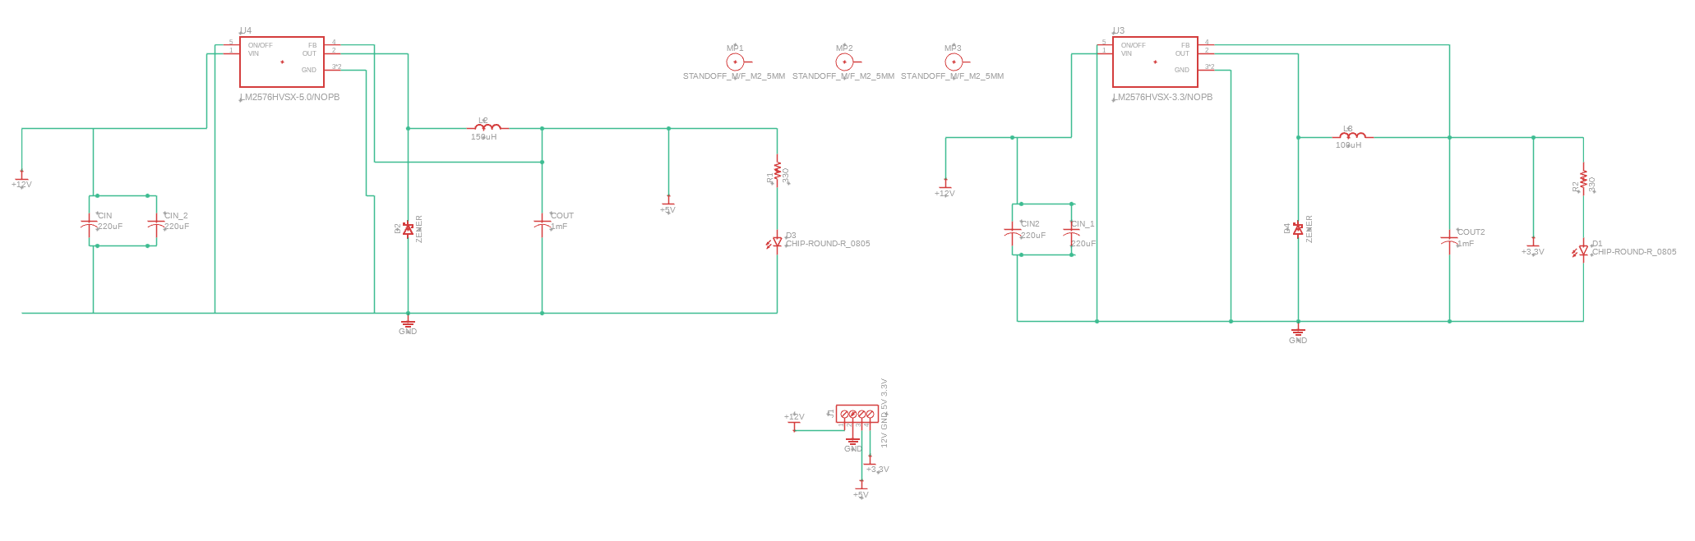
Regulator Board Schematic

Slide 32
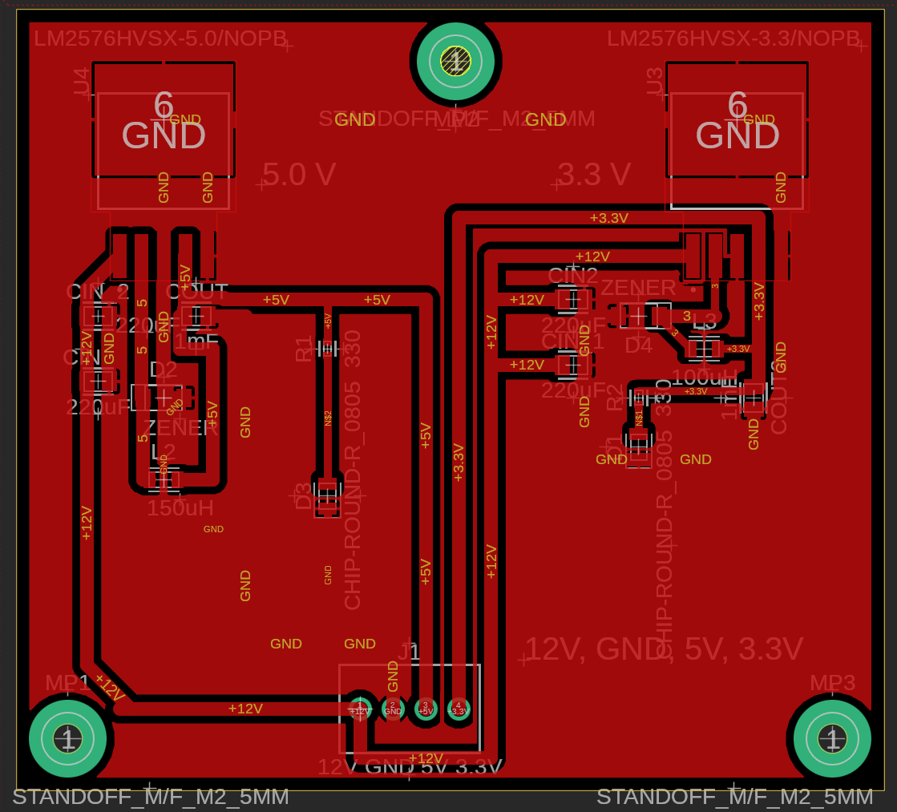
PCB Layout

Slide 33
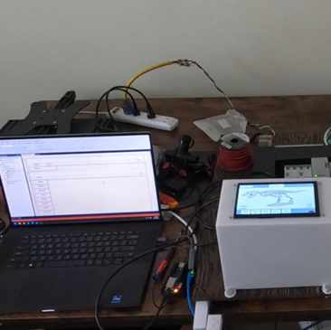
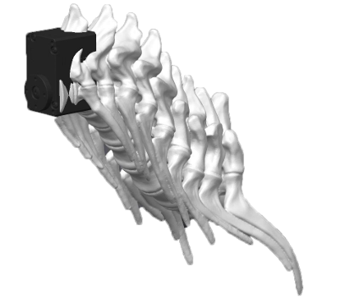
Prototyping & Testing

Slide 34
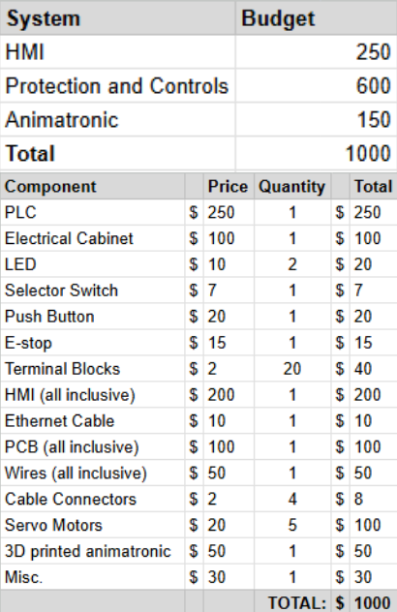
Planned Cost
Put planned cost next to actual cost in one slide

Slide 35
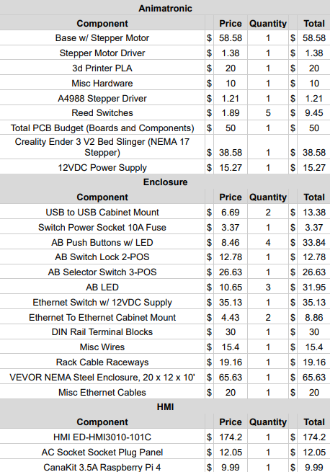
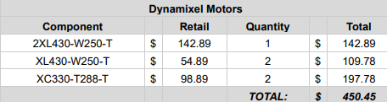
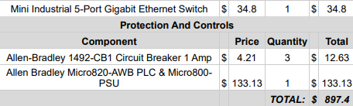

Actual Cost

Slide 36
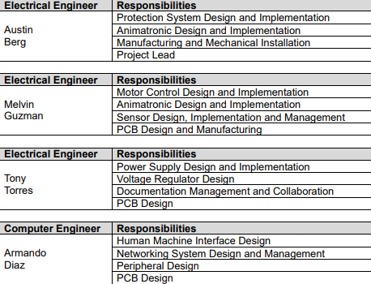
Work Distribution

Slide 37
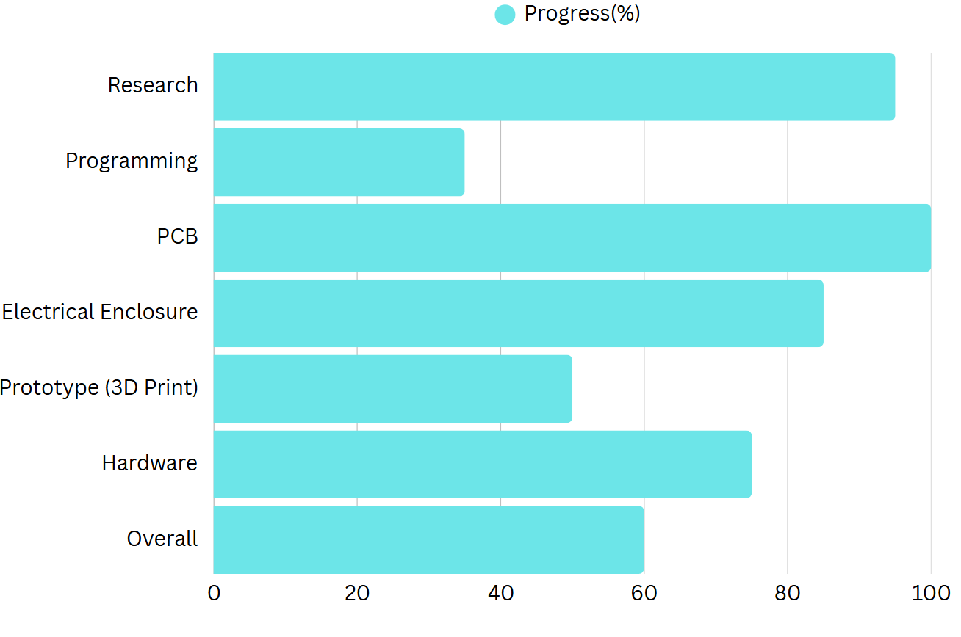

Plan for Completion

